Slide 1
Internet of Things (IoT)
Basic introduction and practical example of IoT

Slide 2
Agenda
What is IoT
Need of IoT
Application of IoT
Practical demo of IoT with Video call

Slide 3
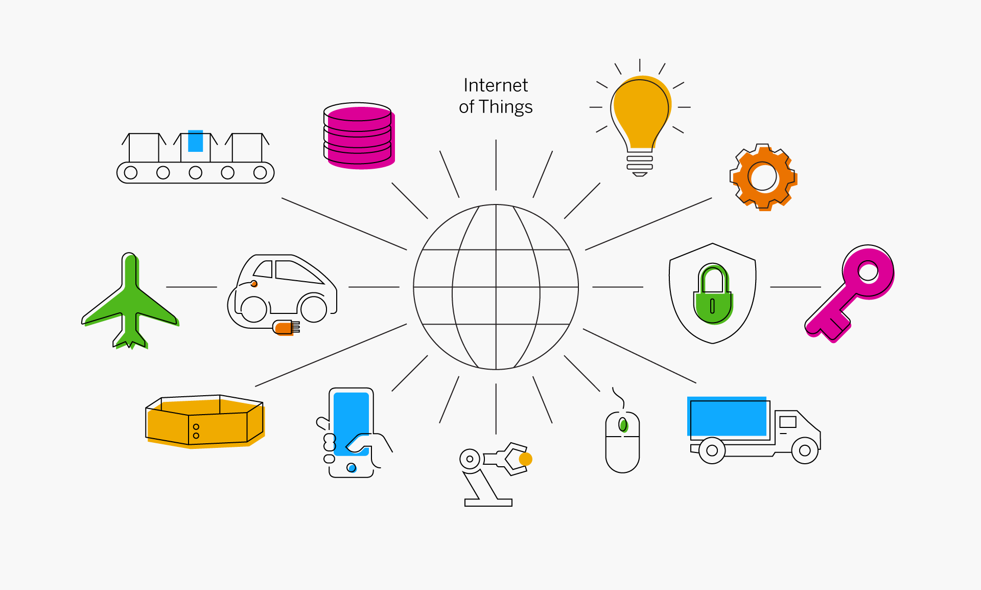

What is Internet of Things ?
IoT stands for Internet of Things. IoT is a platform where regular device are connected with the internet ,so they can interact , collaborate and exchange data with each other.
Internet
Things

Slide 4
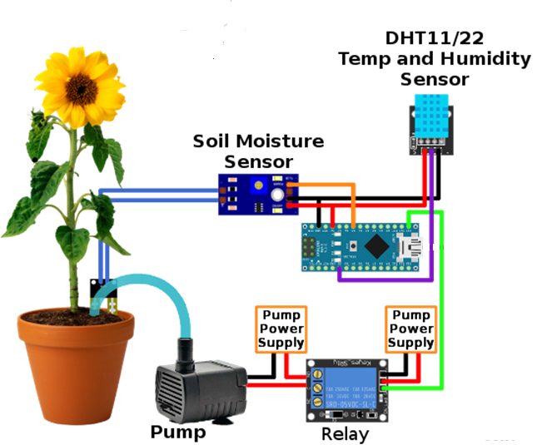
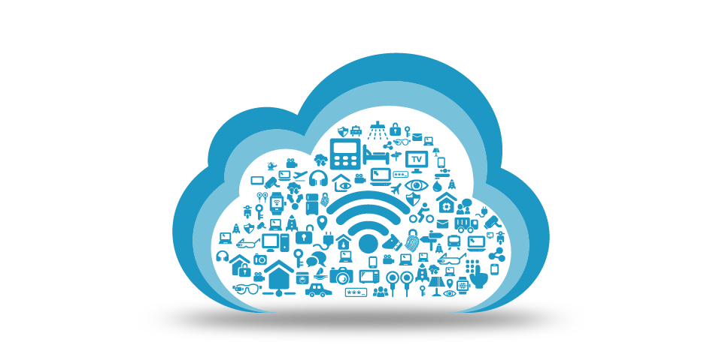
Need of Iot ?

Slide 5
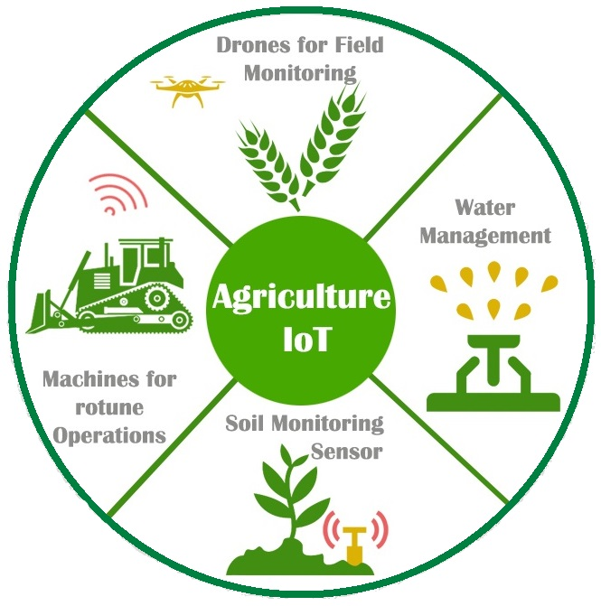
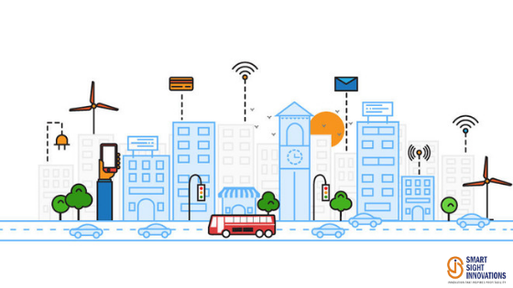
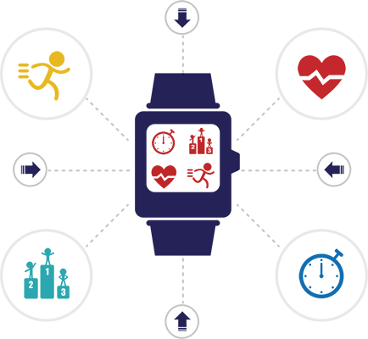
Application of IoT ?
Agriculture
Smart Cities
Health Care

Slide 6
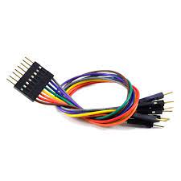
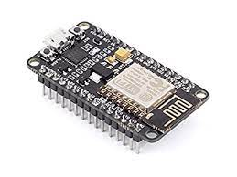


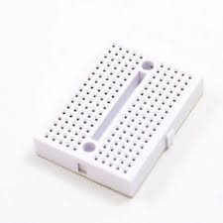
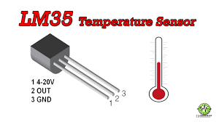


Practical Demo of IoT application
Home Automation & Fire Detection system
Technology used for developing this Project

